Slide 1

Advanced SQL Interactive

Slide 2
What we aim to cover in this course
https://deloittedevelopment.udemy.com/course/sql-intro/learn/lecture/37258204#overview

Slide 3
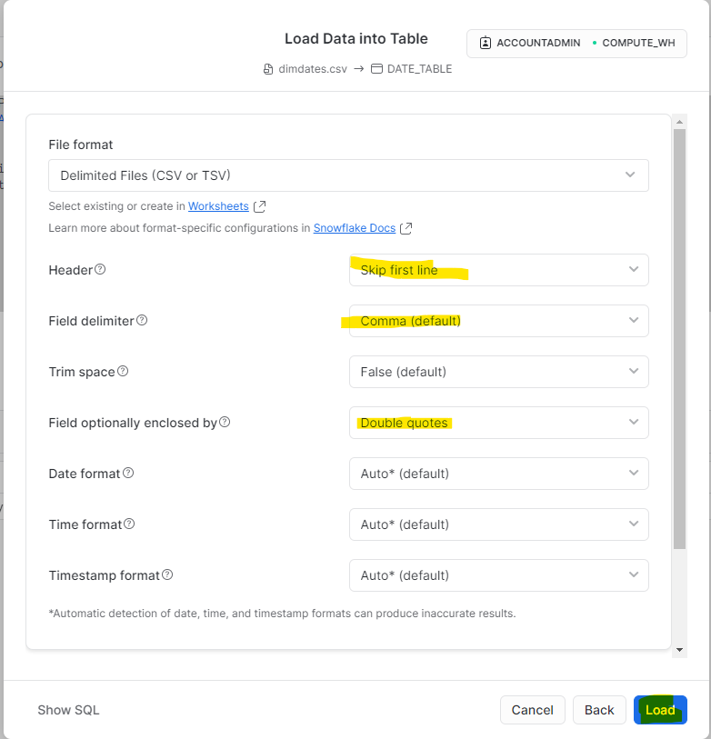
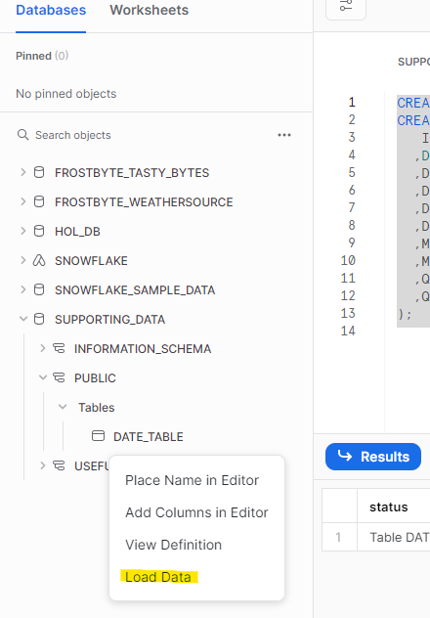
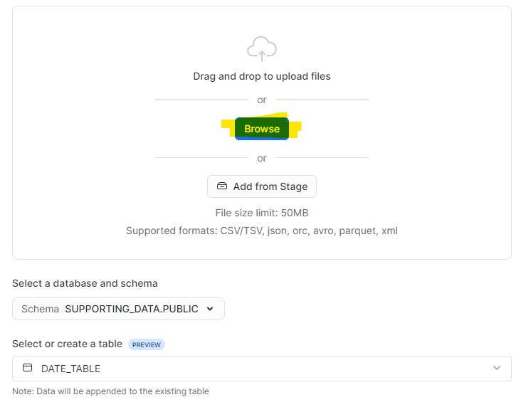
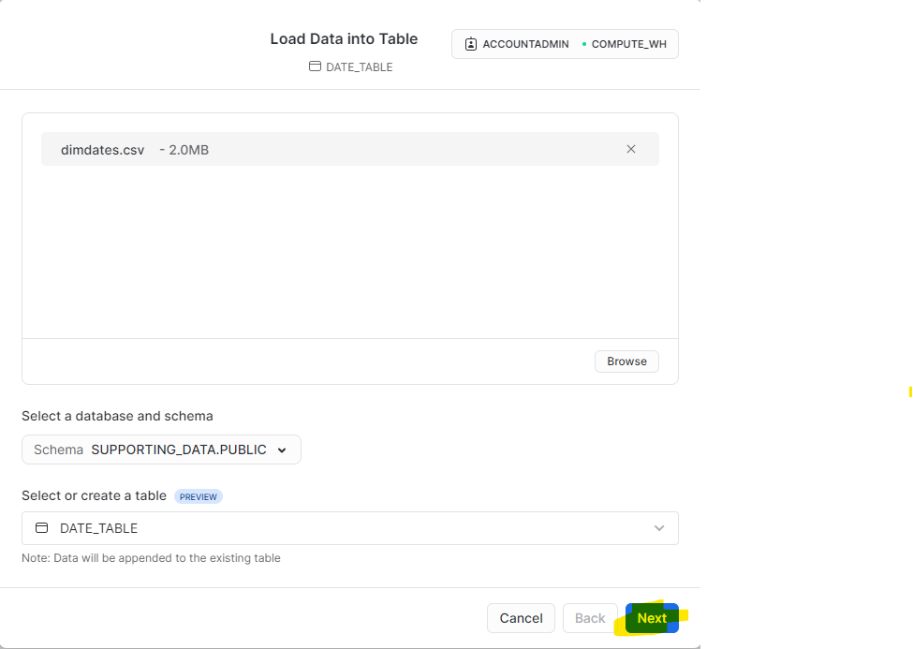
Creating and loading the date table
Open the 01 Create date table file, copy the Query and execute in Snowflake.

Slide 4
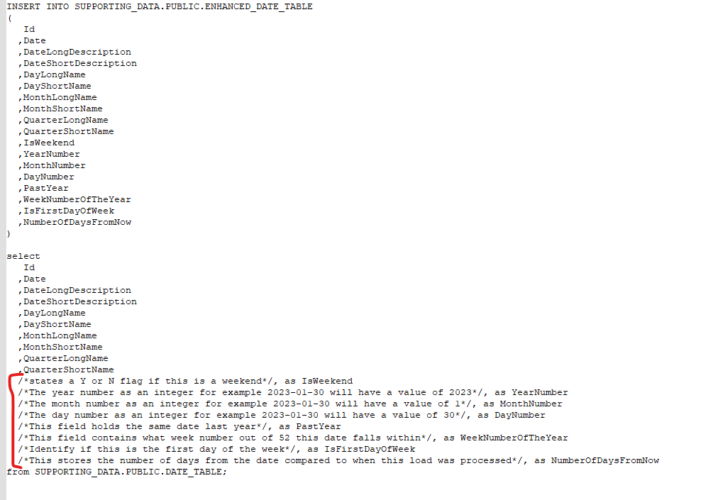
Adding extra columns to the table
Open Script 02 enhanced date table and take a crack at writing the code to calculate the missing columns

Slide 5
Sub Queries
Refer to file 03 Sub Queries

Slide 6

Sub Queries – Exercise 1
Refer to file 04 Exercise 1
We have two tables, namely menu and trucks.
The client wants to see which trucks from the truck table sell the menu item bottles water from the menu table.

Slide 7
Sub Queries – In or Not In
We use the IN or NOT IN keywords to check if a particular item is in a list of items.
This can be a hardcoded list or by using sub queries a completely different table.

Slide 8

Sub Queries – Exists
Refer to file 05 Exists
Exists is used to see whether a subquery returns any results
It is normally used to check if something already exists in a table, however the more common use of it is to pair it with the NOT keyword.
Not Exists is often used in insert statements to ensure we don’t enter a key that already exists into a table.

Slide 9
Common Table Expressions (CTE’s)
Refer to text file 06 CTE
When you have complex queries that need to go many levels deep, while this can be done with a subquery, often times when things become really complex, the code becomes less readable / testable.
To get around this SQL has a cool feature called CTE’s. CTE’s allow you to write a query in pieces with each part being treated as a somewhat temporary table. This keeps your code clean and readable and also helps with debugging as you can query any of the CTE components.

Slide 10
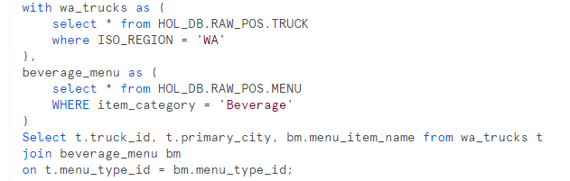
Common Table Expressions (CTE’s)
This is what a CTE looks like.
It uses the WITH clause.
Even though this is a simple example, you can go very complex with CTE’s

Slide 11
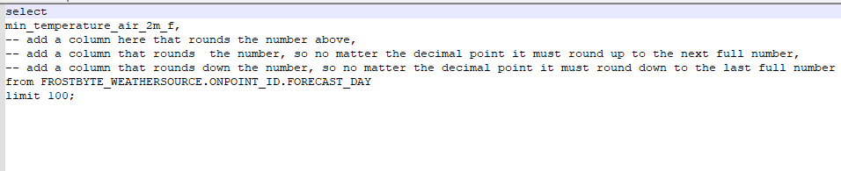
Exercise 2
Open Script 07 Exercise 2
The client wants us to round some numbers, have a look at the ask below and see if you can implement this.

Slide 12
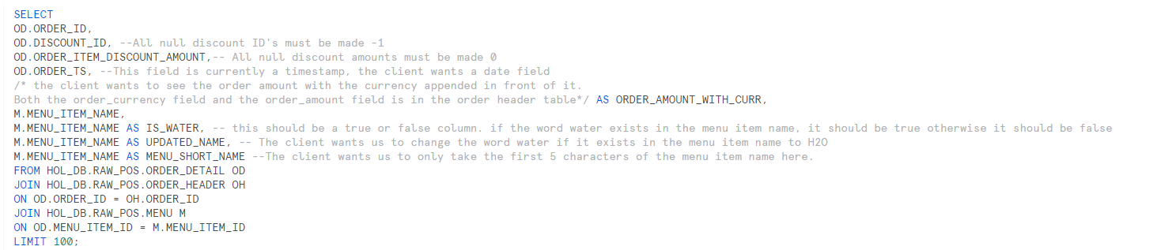
Exercise 3
Open Script 08 Exercise 3
The client needs our help, to help cleanse some of their data. If we look at the SQL below, are you able to address all the clients requests.

Slide 13
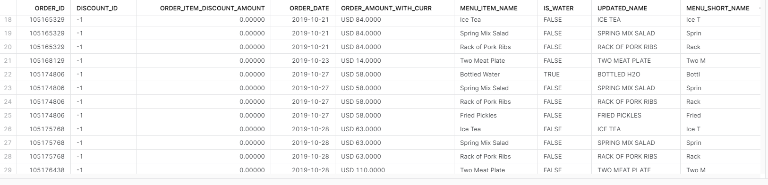
Exercise 3
Your final result set should look like this

Slide 14
Some useful functions
Data Cleansing:
Coalesce and NVL (very similar, but coalesce can be used to choose between two columns where one of the values is not null and NVL is used to apply a default value to Null values)
Trim removes white spaces before and after a string, left trim and right trim do one of the sides.
Pad helps add additional characters to get a string to a uniform length, you can either pad from the left or right, i.e. lpad or rpad.
Greatest or least can be used to cap a number field.

Slide 15
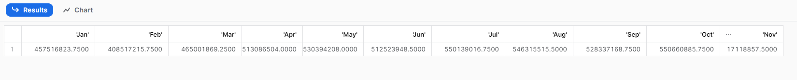
Exercise 4 - Pivoting data
Open Script 09 Exercise 4
At times, you may be required to reshape / restructure data. The most common ask is pivoting or unpivoting data.
Use the code provided and attempt to pivot the data to show sales as a value and the month name as the column for the year 2022. The output should look like the below:

Slide 16
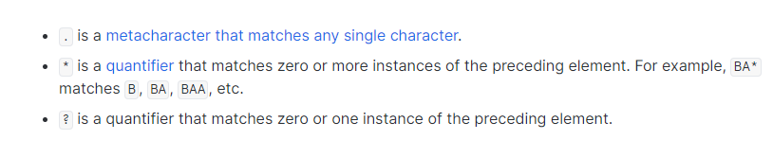
Regular Expressions (RegEx)
Is used to match patterns in strings
RegEx is supported in most programming languages
Metacharacters are symbols that have a special meaning in RegEx.
Example of a regular expression, this one replaces all special characters in a string with a whitespace.

Slide 17
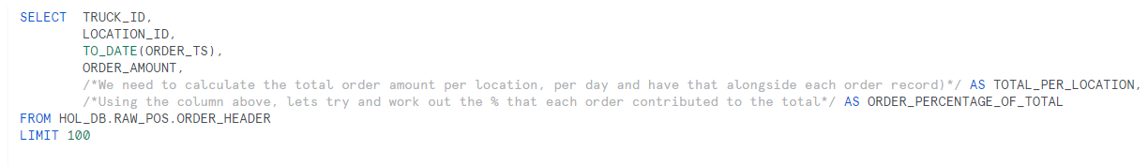
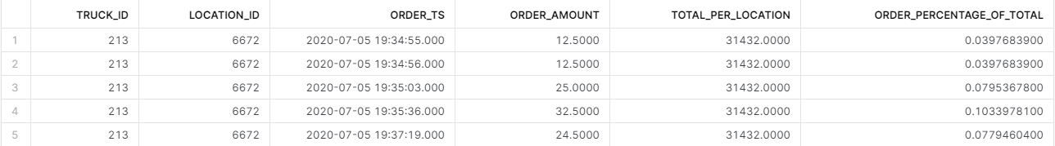
Exercise 5
Open Script 10 Exercise 5
Lets try and do some analytical calcs. Using the query below, lets try and calculate the fields in the comments
The output should look like the below:

Slide 18
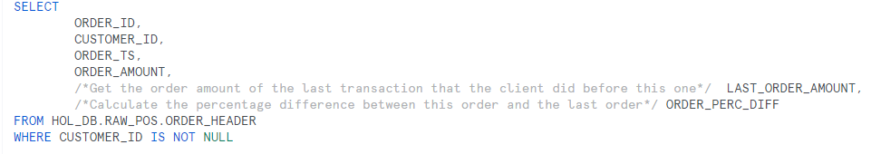
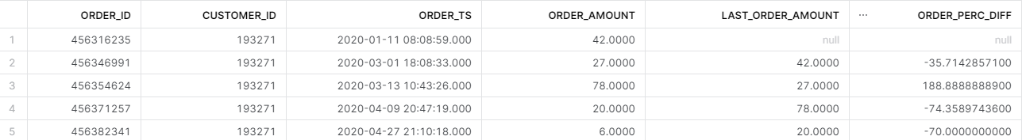
Exercise 6
Open Script 11 Exercise 6
Lets try and build upon our analysis by trying to add the columns commented below
The results should look something like this:

Slide 19
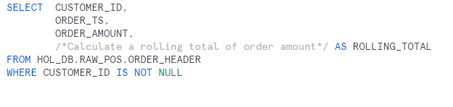
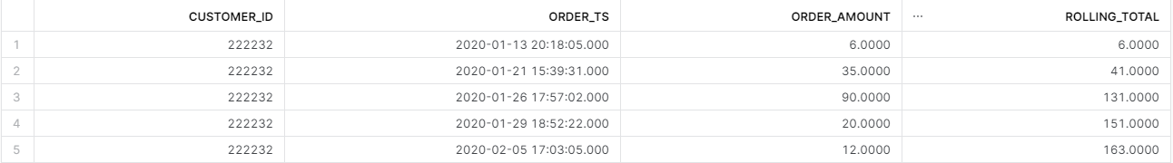
Exercise 7
Open Script 12 Exercise 7
Lets try and calculate a rolling total, in an effort to see how much a customer spends with us, we want to calculate a rolling total to see how his order amount stacks up over time.
The results should look something like this:

Slide 20
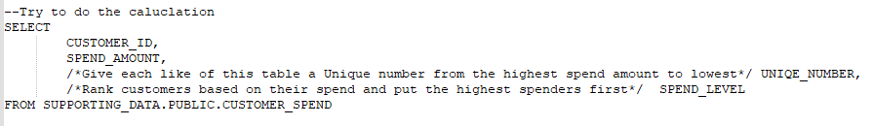
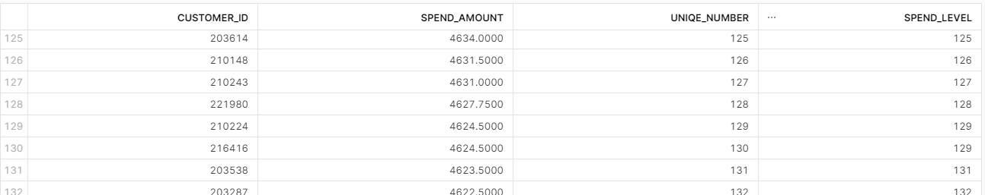
Exercise 8
Open Script 13 Exercise 8
Lets try to arrange our customers by their spend amount
The results should look something like this:

Slide 21
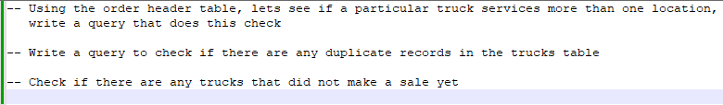
Exercise 9 - Error and sense checking
Open Script 14 Exercise 9
Try to write the queries below

Slide 22
Unions, Minus and Intersect
Union are the most commonly used set operation.
Minus and intersect are quite interesting, lets go through script 15 Minus and Intersect to understand it a little better

Slide 23
Grouping Sets
Open Script 16 Grouping Sets

Slide 24
Functions
Open Script 17 Functions
Users can define functions in most sql tools, these functions are often called user defined functions
Most tools support two variations of functions, a table function and a scalar function
The main differentiator of these functions are the return types, 1 returns a scalar / single item, the other returns a table of results.
Lets look at how we can create a function

Slide 25
Stored Procedures
Open Script 18 Stored Procedures
Stored procedures are another common item among database tools.
One of the most commonly used database objects
Stored procedures differ from functions in the sense that stored procedures can process DML, i.e. they can manipulate the data / structures in the database
This is why stored procedures are normally the go to choice for loading data in the database as these can be orchestrated.
Lets build a simple stored procedure to load our enhanced date table.

Slide 26
Other items to discuss if we finish early
Transaction management (savepoint, commits, rollbacks, database locks)
Table Partitioning
Triggers
Explain plans (performance tuning)
Error Handling
Logging

Slide 27
Questions?

